Slide 1
12th of June 2018
Aligned Nordic-Baltic power markets
Mats Persson
Fortum

Slide 2
Aligned Nordic-Baltic power markets
Fortum in Brief
Prerequisites for a well working power market
Nordic-Baltic power market development so far so good but….
Ways forward

Slide 3

Fortum in 2017
Key figures 2017
Markets
Sales
EUR 4.5 bn
Nordic countries
Power generation 45.4 TWh
Heat sales 5.0 TWh
Electricity customers 2.4 million
Comparable operating profit
EUR 0.8 bn
Poland
Power generation 0.5 TWh
Heat sales 3.7 TWh
Russia (PAO Fortum)
Power generation 26.3 TWh
Heat sales 19.8 TWh
Balance sheet
EUR 22 bn
Baltic countries
Power generation 0.7 TWh
Heat sales 1.4 TWh
Personnel
8,800
India
Power generation 0.3 TWh

Slide 4
Fortum mid-sized European power generation player; major producer in global heat
Power generation
Heat production
Customers
Largest producers in Europe and Russia, 2016
TWh
Largest global producers, 2016
TWh
Electricity customers in EU, 2016
Millions
EDF
Gazprom
Enel
RWE
T Plus
EDF
Rosenergoatom
Inter RAO UES
Enel
Veolia
RWE
Gazprom
RusHydro
E.ON
Uniper
EDF
RusHydro
Sibgenco
Iberdrola
ENGIE
EuroSibEnergo
CEZ
Inter RAO UES
Fortum
Vattenfall
Quadra
DEI
NNEGC Energoat.
Vattenfall
Centrica
Iberdrola
Beijing DH
Fortum
TGC-2
EDP
EPH
SIBECO
ENGIE
EuroSibEnergo
KDHC
Statkraft
Minskenergo
Vattenfall
CEZ
Lukoil
EnBW
T Plus
PGE
PGE
Tatenergo
PGE
EnBW
DTEK
SSE
EDP
PGNiG
DTEK
Ørsted
Tauron
EPS
Stockholm Exergi
Gas Natural
Fenosa
E.ON
CEZ
Sibgengo
TGC-14
Fortum
Verbund
Helen
Ørsted
DEI
0
100
200
300
400
500
600
0
20
40
60
80
100
120
140
0
10
20
30
40
Source: Company information, Fortum analyses, 2016 figures pro forma

Slide 5
Fortum's carbon exposure among the lowest in Europe
g CO₂/kWh electricity, 2016
2017
61% of Fortum's total power generation CO₂-free
96% of Fortum’s power generation in the EU CO₂-free
173
28
Note:
All figures, except “Fortum total”, include only European power generation.
Fortum’s specific emissions of the power generation in 2017 in the EU were 28 g/kWh and in total 174 g/kWh, same as in the previous year.
Source: PwC, December 2017, Climate Change and Electricity (including those companies with data for power generation available only), Fortum

Slide 6
Fortum's power and heat production by source
Fortum's power generation
in 2017
Fortum's heat production
in 2017
Natural gas 35%
Natural gas 65%
Nuclear power 31%
Others 1%
Peat 1%
Biomass 1%
Heat pumps, electricity 2%
Coal 4%
Biomass 7%
Waste 8%
Hydropower 28%
Coal 17%
Total generation 73.2 TWh
(Generation capacity 13,722 MW)
Total production 28.6 TWh
(Production capacity 14,765 MW)

Slide 7
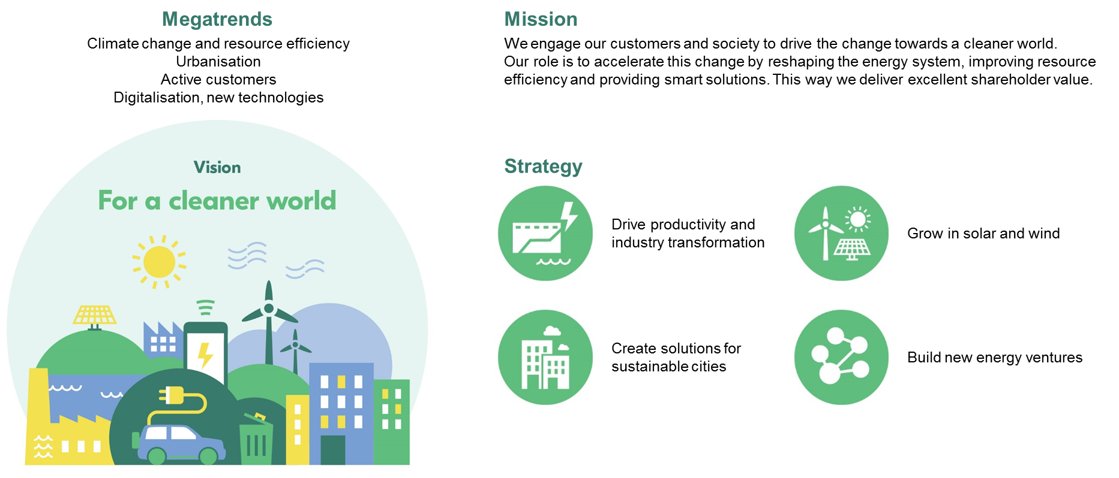
Fortum – For a cleaner world

Slide 8
Aligned Nordic-Baltic power markets
Fortum in Brief
Prerequisites for a well working power market
Nordic-Baltic power market development so far so good but….
Ways forward

Slide 9
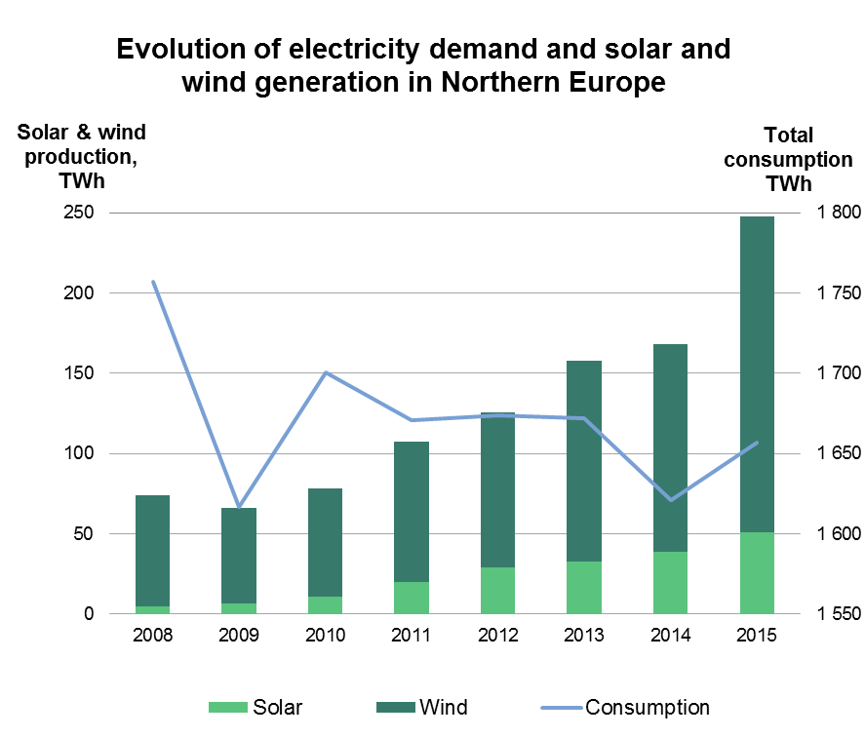
Well-functioning markets and efficient carbon pricing is a must
  Drive decarbonisation with CO₂ pricing
  Integrate all RES into the market
  Integrated EU electricity markets through regional cooperation
  Develop the after-spot markets
  Enforce link between wholesale and retail markets
  Put more effort on grid development
Northern Europe: Nordics, Baltics, Poland, Germany, Benelux, UK, Ireland
Sources: ENTSO-E; UCTE, Nordel and Eurostat statistics (2008)

Slide 10
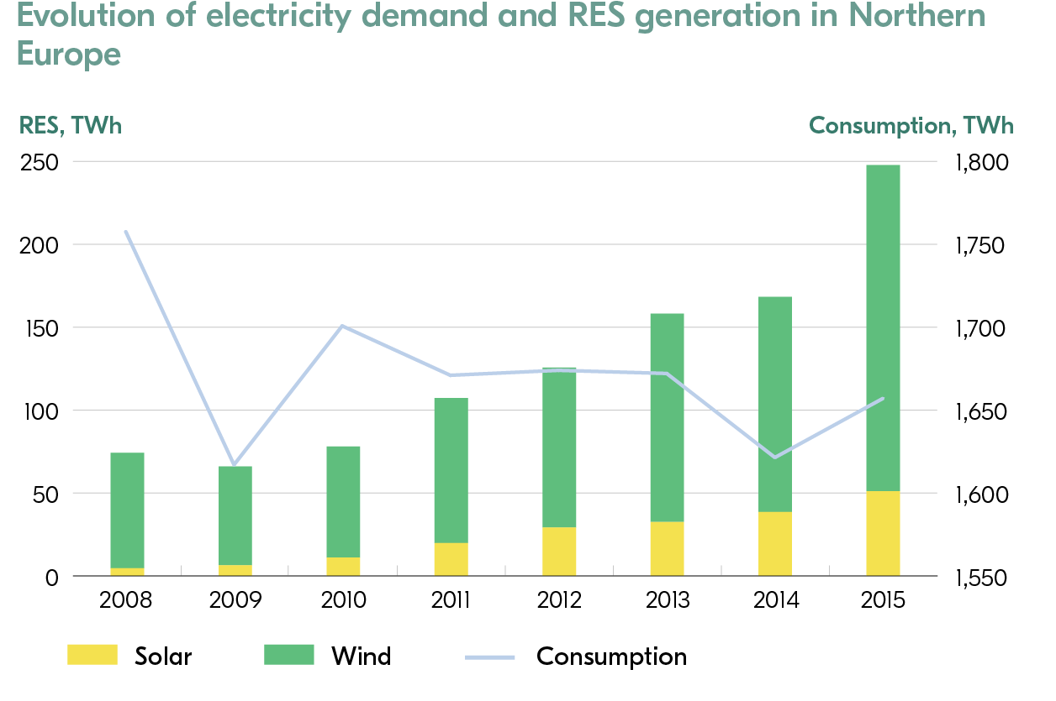
Market design should develop in the same direction in all countries forming the Nordic power market
Challenge
No market design solution can be efficient if large-scale investments happen outside the market, driven by subsidies
National focus on electricity market design and energy policy development leads to solutions damaging the benefits of the efficient cross-border trade
Solution
Tight coordination of national policies between countries belonging to the same regional market (the Nordic Council of Ministers could be the platform)
Involve the Baltic states in the Nordic co-operation
Establishment of a broad stakeholder platform consisting of energy industry representatives, TSOs, regulators, and ministries
Northern Europe: Nordics, Baltics, Poland, Germany, Benelux, UK, Ireland
Sources: ENTSO-E; UCTE, Nordel and Eurostat statistics (2008)

Slide 11
Scarcity cost should be correctly reflected in market prices
Development of the after-spot markets is important but will not change the situation without solving the core problem related to oversupply
Challenge
There are several barriers to engaging all resources available in the market in balancing the system
Physical deliveries
Nord Pool
Balancing and reserve
markets
Solution
Järjestelmä-vastaava(t)
One-price imbalance pricing for both consumption and production
Real-time publishing of balancing prices
Fair price formation when tertiary reserves are activated
Shorten the intraday and balancing markets gate closure times
Elspot (day-ahead)
Elbas (intraday)
Energinet.dk
2015: ~280 GWh
Svenska Kraftnät
2015: ~1260 GWh
Nord Pool
day-ahead market
2015: ~374 TWh
Delivery
Nord Pool
Intraday
market
2015: ~5 TWh
Statnett
2015: ~1230 GWh
Fingrid
2015: ~230 GWh

Slide 12
Aligned Nordic-Baltic power markets
Fortum in Brief
Prerequisites for a well working power market
Nordic-Baltic power market development so far so good but….
Ways forward

Slide 13
Outcome of far-sighted and persistent development to create the Nordic-Baltic power market
Nord Pool market was created in 1993
Nordic electricity market is the outcome of far-sighted and determined cooperation
Today the market covers seven countries (SE, NO, FI, DK, EE, LV, LT)
First cross-border power line between Sweden and Denmark
Nord Pool, a joint Norwegian-Swedish power exchange, was established
Estonia joined Nord Pool
Lithuania joined
Nord Pool
Latvia joined Nord Pool
European-wide XBID intraday market coupling;
Competition with EPEX Spot entering the Nordic-Baltic market
Denmark joined
Nord Pool
1915
1950
1993
1996
1999
2000
2010
2012
2013
2014
2018
Since 1950’s stronger interconnections built between all Nordic countries, and from the Nordic countries to the European power market
Nordic electricity market liberalisation started with power market deregulation in Norway
Finland joined
Nord Pool
Nord Pool market place divided to Nasdaq Commodities for financial derivatives and Nord Pool for day-ahead and intraday market
Price coupling between Nord Pool and the Polish power exchange
A joined European market coupling system was taken into use
Since then other Nordic countries have deregulated their electricity markets, and the power market in the Baltic countries has been liberalised
Source: Fortum

Slide 14
Nordic infrastructure lacks behind
- Nordic power grid is far from socio-economically optimised
Top ten Nord Pool congestion rent borders in 2016
Nordic and Baltic power market consists of 15 price areas and 15 million consumers.
In total, Nord Pool area congestion rent was roughly 380 MEUR in 2016
Top 5 rents (44% of total) were coming from the following lines:
  FI-SE1 (11.0%)
  DK1-NO2 (9.0%)
  FI-SE3 (8.6%)
  NO1-NO5 (8.0%)
  NO1-SE3 (7.5%)
The notable congestion indicates there still is a lot to be done in further strengthening the grid connections internally within the Nordics
NO4
SE1
42 MEUR
14 MEUR
SE2
FI
NO3
16 MEUR
NO5
NO1
33 MEUR
30 MEUR
NO2
SE3
29 MEUR
EE
34 MEUR
18 MEUR
19 MEUR
DK1
SE4
LV
DK2
28 MEUR
LT
PL
Source: Nord Pool 2016 data

Slide 15
Aligned Nordic-Baltic power markets
Fortum in Brief
Prerequisites for a well working power market
Nordic-Baltic power market development so far so good but….
Ways forward

Slide 16
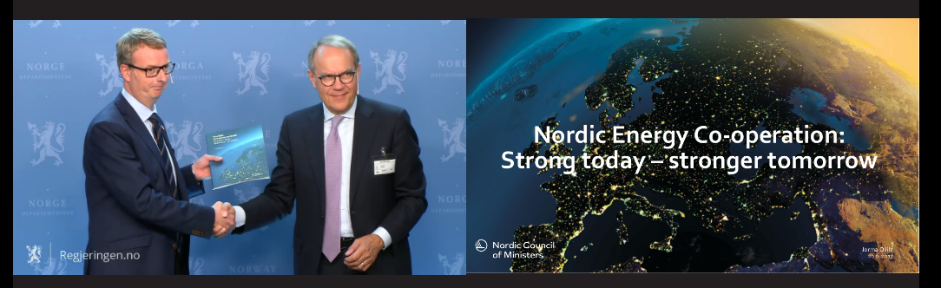
Report presented to the Nordic Council of Ministers 20 June 2017
Press release at http://www.norden.org/en/news-and-events/news/201ccloser-co-operation-on-energy-will-keep-the-nordic-region-on-top201d
The report is available at http://norden.diva-portal.org/smash/get/diva2:1106010/FULLTEXT01.pdf

Slide 17
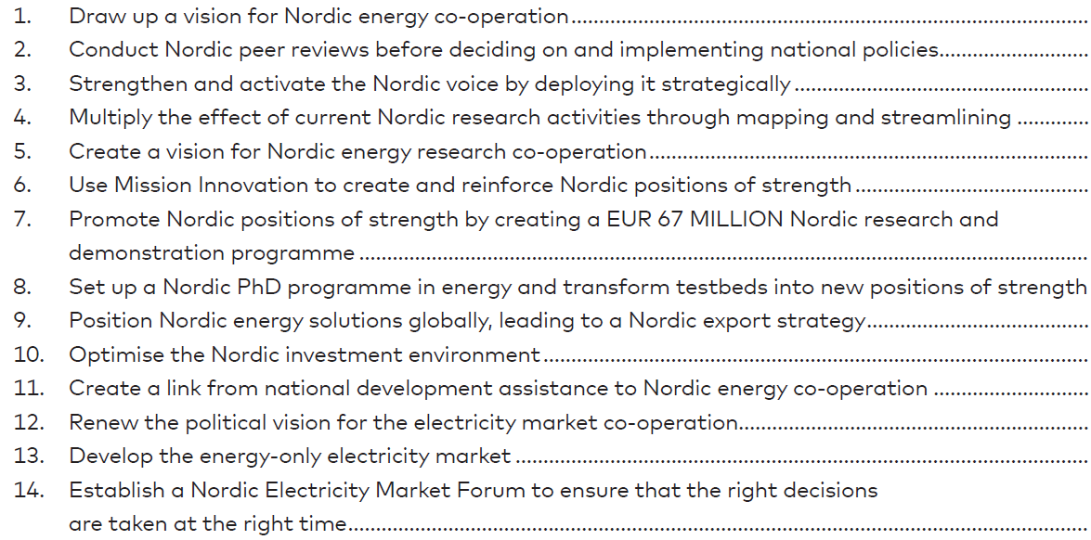
Report includes 14 proposals for enhanced Nordic co-operation

Slide 18
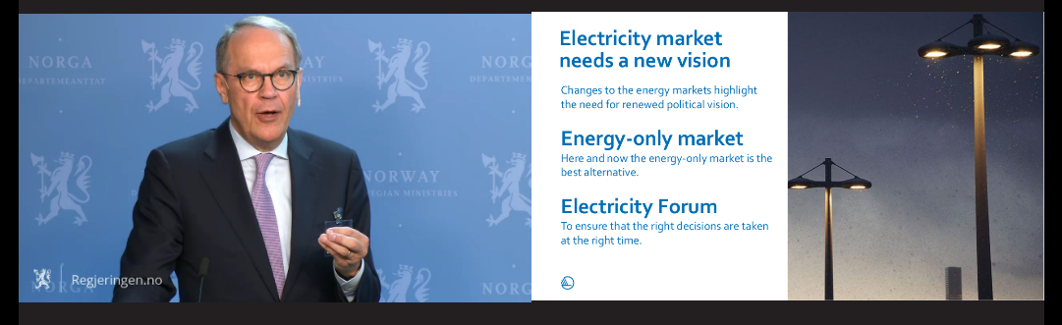
Clear direction needed for the Nordic electricity market
“This review does not foresee a need for a capacity market if the right adaptations are made in the light of current market trends, including closer focus on demand response. However, if needed at some point in time, it should be emphasised that mechanisms designed to ensure adequate capacity must be as regional, as market-based and as limited as possible, e.g. as a regional strategic reserve.”
“A well-functioning, regional, energy-only market should be the point of departure for political discussion on the further development of electricity market integration.”

Slide 19
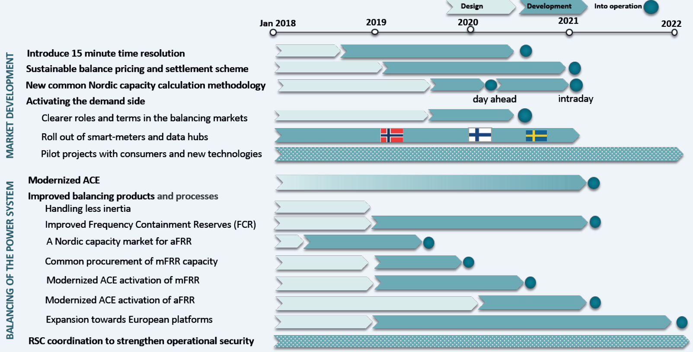
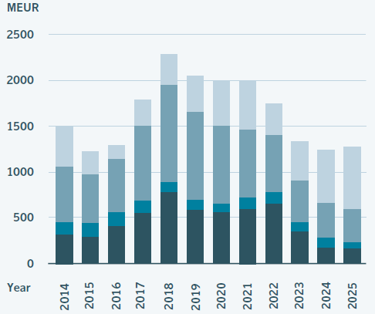
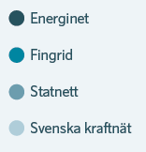
Nordic TSOs’ Solutions Report proposes market enhancements
- Both market development and grid investments needed for future power system
TSOs’ Solutions Report for the Nordic power market development was published for stakeholders on 18 April
The solutions are developed and implemented on three levels: Nordic energy policy, Common system solutions, and Dedicated solutions
The report includes roadmaps for 2018-2022 in four areas: market development, balancing of the power system, grid development, and ICT solutions
Modernised ACE (Area Control Error) balancing to be taken into use in 2021 in the Nordic synchronous region
Roadmaps for market development and power system balancing
Total investments by the Nordic TSOs
Source: The Way forward – Solutions for a changing Nordic power system, Nordic TSOs, March 2018

Slide 20
Fortum is a firm supporter of the Nordic-Baltic energy cooperation
Key issues to tackle when going further in the Nordic power market development:
  Common strategy on regional grid planning process, plan grid investments at regional level.
  Genuine integration of the Nordic and Baltic power market including different cooperation forums and TSO cooperation.
  Critical assessment of the impact of existing price areas (15 price areas in the Nordic-Baltic power market) on generation investments, especially wind, in the Nordics.
  Promote best practices in permitting processes (lessons learned from different countries) relating to grid and generation investments.
  Development of grid tariffs and assess the impact of grid tariffs on investments.
  Relaunch a process of Nordic retail market harmonization. New services call for larger markets to carry the development costs. If we are successful in the Nordics these services could also be "exported" further.
  Harmonised standards for demand response solutions and services, including common approach to taxation of electricity storages
  Coordination of the datahub development in all Nordic countries to enable a smooth transit to the 15-minute imbalance settlement and trading period in all Nordic countries
  Sector coupling i.e. the role of carbon-free electricity replacing fossil fuels in industry, traffic and heating e.g. through power-to-gas technologies, and how to support this e.g. through taxation and grid tariffs in the Nordics.
  Stronger policy coordination (national strategies and targets) between countries belonging to the same regional market

Slide 21
Nordic energy cooperation – how to ensure that the voice of energy industry will be heard
Fortum has contributed actively in the discussion on the development of the Nordic energy cooperation
  Both before and after “Ollila Report”
    We fully support the proposals presented in the report. The key is to ensure that these proposals are now implemented
    Regional stakeholder forum very welcome proposal – important channel for energy industry to send messages to Nordic Energy Ministers
  Relating to the implementation of the stakeholder forum
    The Fortum should focus on issues relating to the Nordic electricity market development as well as policy issues that have an impact on electricity market.
    All relevant stakeholder groups should be involved in the discussions, including preferably companies that are active in several NordPool countries.
    There should be a clear link between the forum and the ministerial meeting so that the forum would prepare issues for the energy ministers to discuss and decide.
    Regular meetings at Director General level should be initiated. Meetings at DG level could be utilised for channeling the issues requiring political decision and commitment from the (more expert level) stakeholder forum to Energy ministers.
    Permanent resources/secretary for the stakeholder group should be secured, e.g. in the context of Nordic Council organization (or NEF). Without permanent secretariat it is difficult to ensure continuity.
    Baltic countries should be invited to the stakeholder forum.
    The EU Commission should also be involved in the stakeholder forum
    The stakeholder forum should also deliver meetings (e.g. prepare concrete input for ministers to decide), hence the number of issues should be kept limited and make sure that those selected issues will lead to concrete actions and implementation

Slide 22
Outcome of the Nordic Energy Ministers’ meeting in Lund on 22.5.2018
Ministers decided to establish the Nordic electricity market forum
  First meeting to take place in November
Nordic EMG (representatives from ministries) will be responsible for preparations.
  Long term vision for the Nordic energy market; will be based on the national energy strategies
  Regional security of supply (tbc)
Energy ministers want to strengthen Nordic leadership in global energy transition
  Energy companies and associations are asked to develop ideas to increase export of the Nordic energy technologies and competences relating to sustainable energy technologies.
  These ideas will be raised on the agenda of next year’s energy ministerial meeting in Iceland.

Slide 23
Market coupling milestones – Cross-border power flows optimised by power exchanges
Market coupling between NL, BE and FR since 2006
Germany – Nord Pool coupling started 11/2009
Market coupling for Central Western Europe (DE, FR, NL, BE) since 11/2010 with
a continued coupling with Nord Pool. NorNed (NO-NL) and BritNed (UK-NL) included
in 2011
Nord Pool price area for Estonia in 2010, Lithuania in 2012 and Latvia in 2013. Poland coupled with Nord Pool since 2010
Czech, Slovakia and Hungary coupled together since 2012. Romania joined in 2014
A common day-ahead market coupling for the whole north-western Europe (incl. Spain
& Portugal) was started in 2014. Italy and Slovenia joined in 2015. Ireland to join in 2018
Flow-based cross-border capacity allocation for further trade optimisation taken into use in May 2015 for the CWE region. Nordic flow-based implementation planned for 2021
CEE (Central Eastern Europe) market coupling region due to join latest in 2020 with
flow-based capacity allocation. Switzerland waiting for agreement with the EU
In addition to day-ahead coupling, European-wide intraday market coupling is due
to start with Nordic, Baltic and Continental Western European markets in June 2018
Balancing market integration under development as well, based on both regional projects and the EU Guideline on Electricity Balancing, in force since 18 December 2017
2014
2018-2020
2015
2011
2010-2013
2010
2009
2006
2012-2014

Slide 24
Current transmission capacity from Nordic area is over 6,000 MW
COUNTRIES | TRANSMISSION CAPACITY MW
 | From Nordics | To Nordics
Denmark - Germany | 2,225 | 2,100
Sweden - Germany | 615 | 615
Sweden - Poland | 600 | 600
Sweden - Lithuania | 700 | 700
Norway - Netherlands | 723 | 723
Finland - Estonia | 1,016 | 1,016
Finland - Russia | 320 | 1,300
Total | 6,199 | 7,054
320
1,016
700
723
Theoretical maximum in transmission capacity ~40 TWh per annum, but restrictions especially between DK & DE
Net export from the Nordic area to Continental Europe and Baltics during year 2017 was 15 TWh
Net export was 18 TWh in 2015 and 10 TWh in 2016
Approximately 25 TWh of net export is now reachable
2,225
600
615

Slide 25
Nordic, Baltic, Continental and UK markets are integrating
– Interconnection capacity will double by 2023
The Northern Seas Offshore Grid and the Baltic Energy Market Integration Plan are included as priority electricity corridors in EU’s Infrastructure Guidelines, approved in April 2013
New interconnections will double the
export capacity to over 12,000 MW by 2023
1
Two 1,400 MW NO-UK links as EU Projects of Common Interest: NSL to England due to be ready in 2021, NorthConnect to Scotland still requiring Norwegian permission
New internal Nordic grid investments provide
for increased available capacity for export to
the Continent and Baltics
6
EU’s Connecting Europe Facility co-financing 3rd EE-LV transmission line, due to be ready in 2020
2
1,400 MW NordLink as first direct NO-DE link is being built by end-2019
1
7
Svenska Kraftnät and 50Hertz signed 1/2017
a cooperation agreement on building the 700 MW Hansa PowerBridge DC link between Sweden
and Germany by 2025/26
2
6
3
1,400 MW DK-UK Viking Link under final permitting in the UK, with commissioning timetable to be determined during 2018
3
7
4
700 MW COBRAcable from DK to NL due to be ready in February 2019
4
5
8
8
New 400 MW Zealand – DE connection via Kriegers Flak offshore wind area by 2/2019
5
Jutland – DE capacity planned to grow by 860 MW in 2020, with further 1,000 MW increase in 2022
New interconnectors
New Nordic lines
Existing interconnectors

