Slide 1
EU Market Design Proposal –
Essentials
Dr. Oliver Koch
EU Commission
DG Energy
This presentation reflects solely the views of the author
and does not bind the EU Commission

Slide 2
  Market Design Reform
  Overview
  Wholesale market reforms
  Retail market reforms
  => Value for consumers
Notes:
So far for the background on WHY we propose a reform of the current energy market legislation.
We will now give a short overview of the main elements of the reform we propose:

Slide 3
  Background
Notes:
So far for the background on WHY we propose a reform of the current energy market legislation.
We will now give a short overview of the main elements of the reform we propose:

Slide 4
State of Play
Policy Framework
EU POLICY FRAMEWORK 2030
-20%
GHG
EMISSIONS
20%
RENEWABLE
ENERGY
20%
ENERGY
EFFICIENCY
10%
INTER
CONNECTION
2020
-40%
GHG
EMISSIONS
27%
RENEWABLE
ENERGY
30%
ENERGY
EFFICIENCY
15%
INTER
CONNECTION
2030
Our energy market needs to be re-designed to integrate a growing share of renewable energy sources at the lowest possible cost.

Slide 5
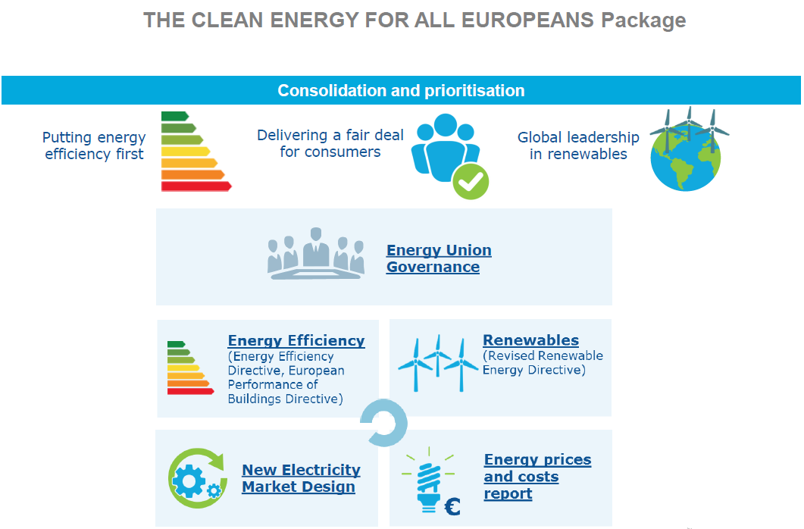

Slide 6
  Intro:
  -
  Flexibilisation

Slide 7
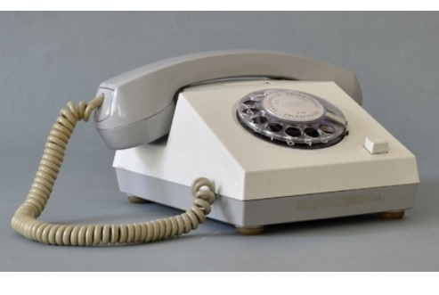

Intro:
Flexibilisation
Old world…
…new world
Notes:
Electricity markets are in the middle of a profound change - some say a ’disruptive change‘ such as with the rise of the internet and smartphones; what is this change about?
Old electricity world: A few large, central power plants – fossile / nuclear; stable production
Generation world has change and will change further: Decentral production from smaller generators, mainly wind and sun. Much more variable production;
Great for competition and consumers who can produce their own electricity; however:
Less predictable => short-term trading becomes more important
Need for backup in case no wind is blowing, no sun is shining.
RES needs aggregation over larger areas; need for an integrated market increases significantly

Slide 8


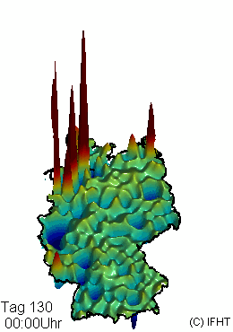
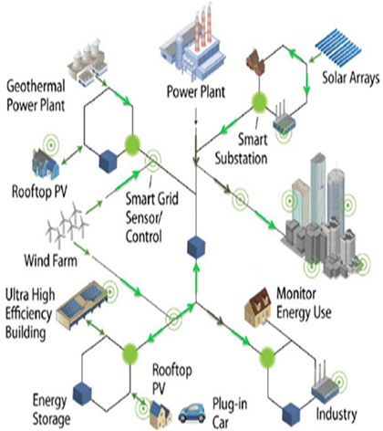

Disruptive change: From central / baseload to decentral / volatile
Old Electricity World
New Electricity World
500MW
250MW
0MW
-250MW
-500MW
Notes:
Electricity markets are in the middle of a profound change - some say a ’disruptive change‘ such as with the rise of the internet and smartphones; what is this change about?
Old electricity world: A few large, central power plants – fossile / nuclear; stable production
Generation world has change and will change further: Decentral production from smaller generators, mainly wind and sun. Much more variable production;
Great for competition and consumers who can produce their own electricity; however:
Less predictable => short-term trading becomes more important
Need for backup in case no wind is blowing, no sun is shining.
RES needs aggregation over larger areas; need for an integrated market increases significantly

Slide 9
  Market Design Reform
  -
  Wholesale market measures
Notes:
So far for the background on WHY we propose a reform of the current energy market legislation.
We will now give a short overview of the main elements of the reform we propose:

Slide 10



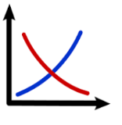
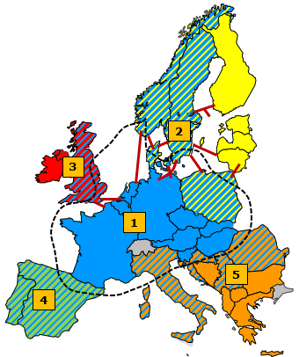

Reform Proposals Market Design
  What do we propose?
  Adapt market rules to new realities
  Reduce state interventions – use markets
  Cooperate across borders

Slide 11
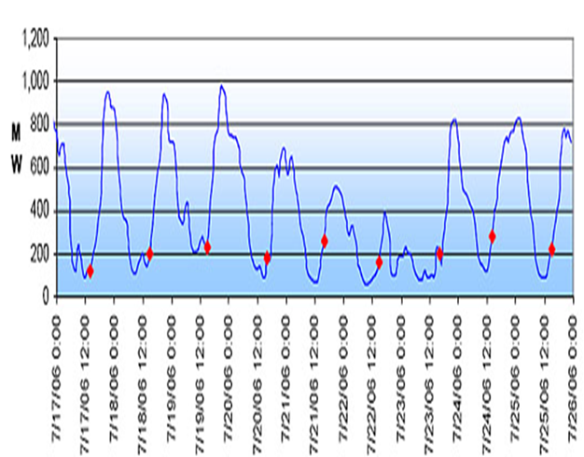
Adapt Rules to new Realities
(…and save money)
Reform Proposals Market Design
  Create EU-Short-term Markets
  EU-wide intraday and & Balancing markets
  instead forward/day-ahead only
15 minutes
trading

Slide 12
Adapt Rules to new Realities
(…and save money)
Reform Proposals Market Design
Demand/supply/grid capacities differ (time/location)
  Prices should reflect demand & supply (time/location)
  Abolish regulated prices, politically motivated price zones and “price caps” as they…
…prevent effective price formation
…lead to power flows to "wrong" place/at "wrong" time
… prevent investments where needed
…increase costs for consumers – hide variablity

Slide 13
Use Market Forces to Bring Prices down & Reduce Distortions from State Interventions
Reform Proposals Market Design
Notes:
We can be open
13

Slide 14


Use Market Forces to Bring Prices down & Reduce Distortions from State Interventions
Reform Proposals Market Design
Outdated/fragmented state aid for renewables (& coal)
Old: "produce and forget" New: Market Orientation
Outdated/fragmented state aid for generators
("Capacity Mechanisms" and "strategic reserves")
Old: Generator-driven New: Joint needs assessment
More market-compatible design
=> Make State Interventions compatibel with market
Notes:
We can be open
14

Slide 15
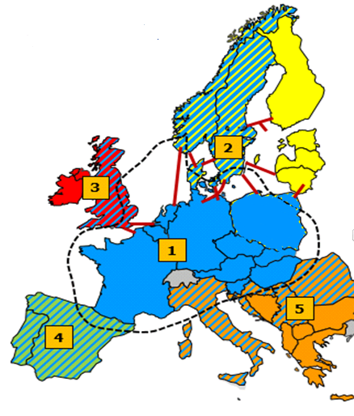

Reform Proposals Market Design
Increased use of Regional Cooperation –
Overcome fragmented island solutions
NOT new!
Regional TSO/ACER decisions existi already under EU-law
(e.g. network codes)
"ROCs": Obligatory cooperation of TSOs; more security; decrease costs, increase trade
€5.35
billion
ACER: Binding cooerdinated decisions – if indispensible
(e.g. "Market Coupling")
European Needs Assessment Common Framework for market-compatible capacity mechanisms
(Pre-) coordinated
crisis management

Slide 16
  Market Design Reform
  -
  Retail market measures
Notes:
So far for the background on WHY we propose a reform of the current energy market legislation.
We will now give a short overview of the main elements of the reform we propose:

Slide 17

Market Design Reform:
Elements
Update Retail Markets

Slide 18
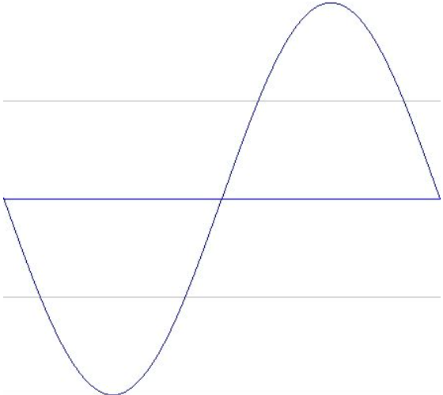
Intro:
Flexibilisation
Earning money with electricity demand:
Coping more effectively with deficits and peaks
Generationsurplus
Generation
deficit
Demand
Classic: Pay backup generation
Alternative: Postpone consumption…
(…and earn money…)
Classic: Curtail generation
Or: Activate consumption
(and save money…)
Notes:
A last key feature of the new flexible electricity market conserns the consumer:
In the new market, generation will always vary much more than before – sometimes there will be too much energy in a region, sometimes too little. This opens the chance for consumers to participate in markets:
In times of supply scarcity, large alumnium plants, for example, can earn money by postponing their production one or two hours; supermarkets by postponing their cooling cycles; there is also the possibility for end-consumers to save or even earn money with flexible consumption.
There will also be times of too much electricity production; on a sunny and windy day, grid operator must often actively reduce generation - or pay consumers to use electricity.
The chances for consumers to participate in electricty markets therefore increase with variable production => we can all earn mony and save costs if we organise the new market well.

Slide 19


Thank you
Energy

Slide 20


Interplay
Third Package & Implementing Legislation
(Network Codes & Guidelines)
SO
3rd
Energy
Package
CACM
BAL
FCA
CACM
RfG
Main legal principles & rules
(including on balancing)
Concretisation of rules,
more technical details
Notes:
Standardisation of balancing products
providing more opportunity for cross-border trading by limiting the number of products used for balancing.
iMerit order activation of balancing energy
ncrease the efficient use of interconnectors and pool resources by establishing European platforms in which balancing energy can be exchanged across Member States.
improSingle Marginal Pricing
giving price signals and integration by ensuring pricing for balancing energy based on marginal pricing (pay-as-cleared).
Balancing energy Gate Closure Time
as close as possible to real time, and at least not before intraday cross-zonal Gate Closure Time (e.g.: 30 minutes for FRR, 60 minutes for RR).

