Slide 1
Danish experiences on integration of wind power
Tallinn, 6 June 2017
Klaus Thostrup, Energinet
Notes:
Tak for invitationen.
Velkommen – alt efter sammenhængen.
Mit navn er: xxx xxx
Jeg vil gerne fortælle helt overordnet om Energinet

Slide 2

Energinet
We own and operate the overall electricity and natural gas transmission system in Denmark.
Our tasks are to integrate renewable energy and ensure security of supply in Denmark
Independent public enterprise owned by the Danish Ministry of Energy, Utilities and Climate
~ 1.000 employees – 8 locations and headquarter in Fredericia
Mission to ensure reliable energy for society
Vision to create balance in a renewable energy system

Slide 3
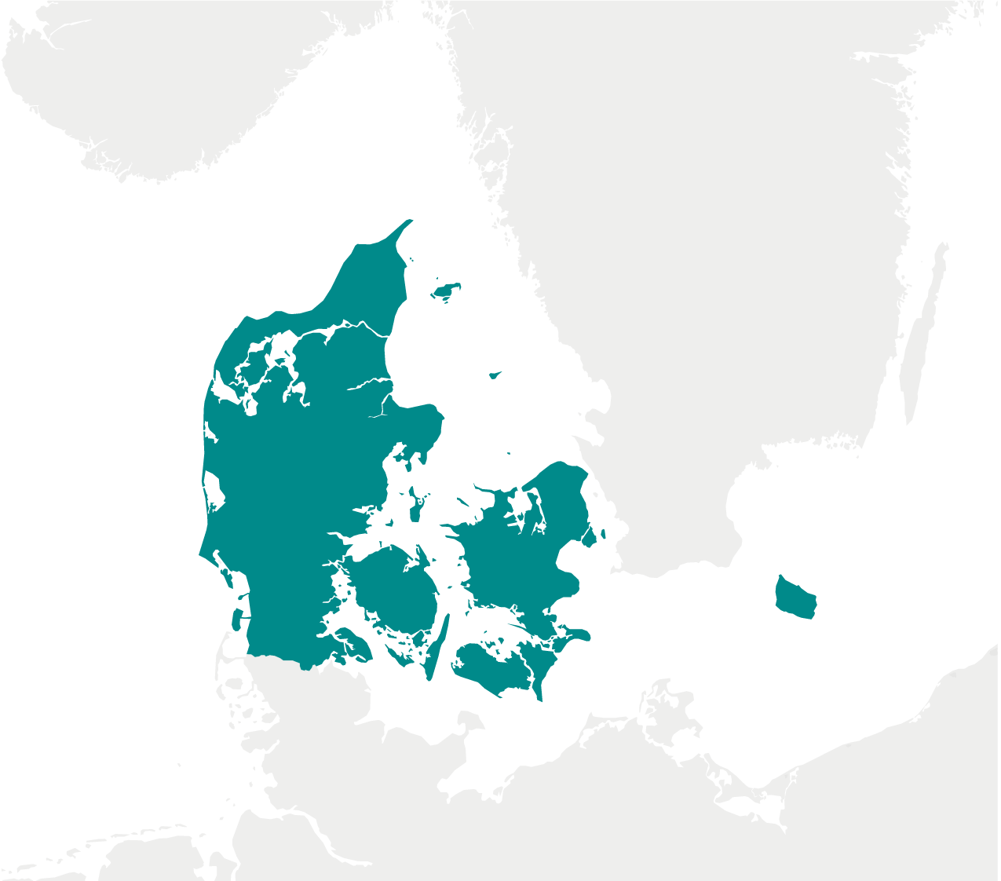

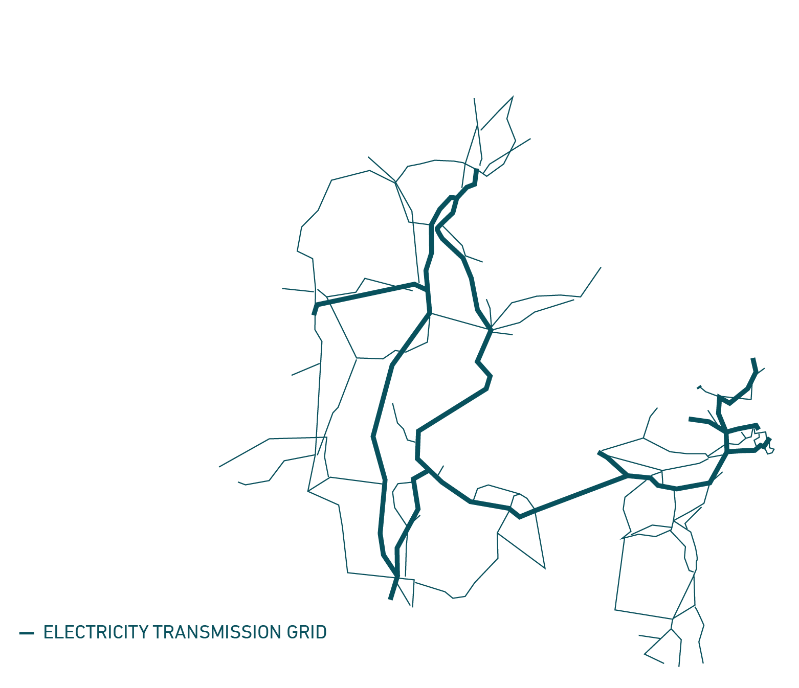

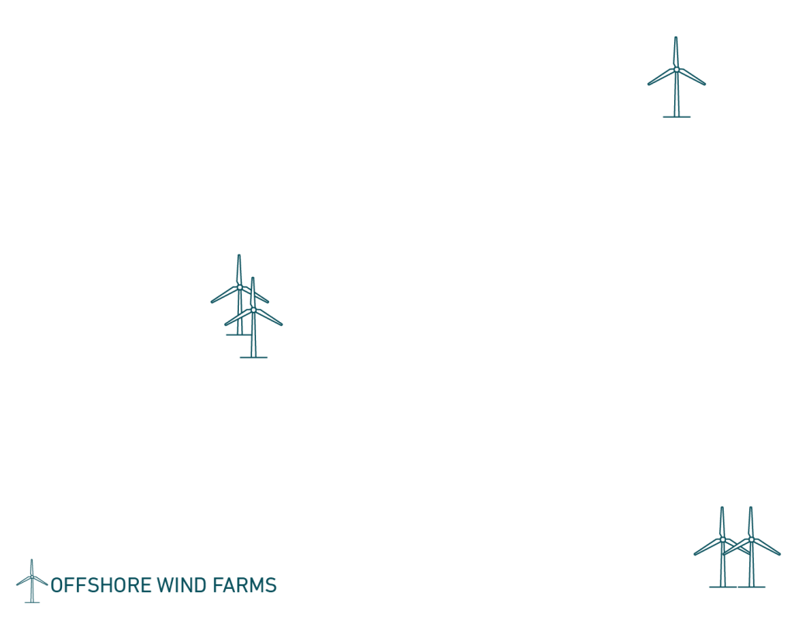

POWER GRID
6,913
km transmission grid
3,770 TWh-km transmitted
5
International interconnections

Slide 4

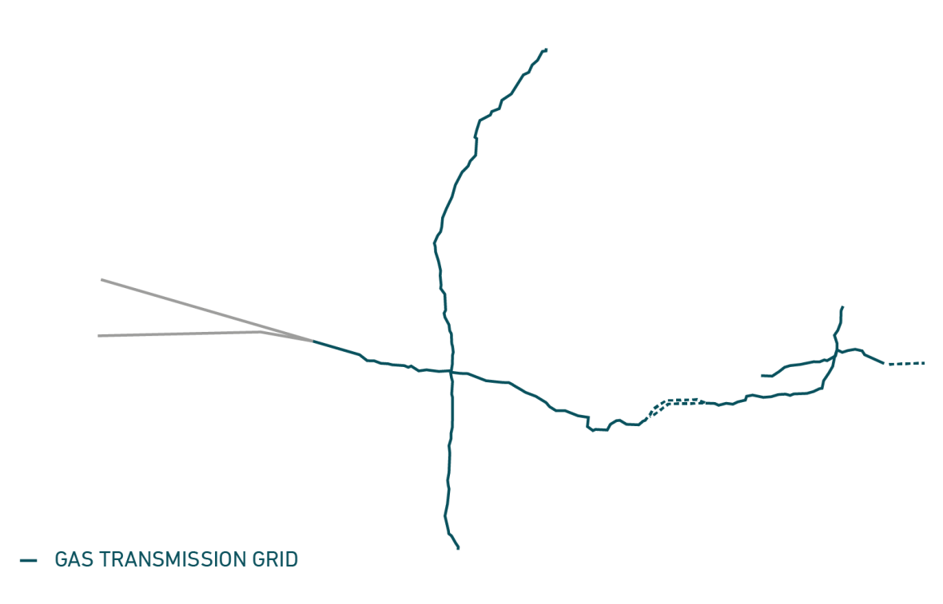



GAS GRID
861
km gas pipelines
4 billion Nm³ transported
6,600 KM
Gas distribution network

Slide 5

The energy system in Denmark is changing
By 2020, wind power will constitute 50% of the electricity consumption
By 2050, Denmark must be completely independent of fossil fuels
Strategic commitments of Energinet:
Security of supply
Efficient green transition
Healthy investment climate

Slide 7
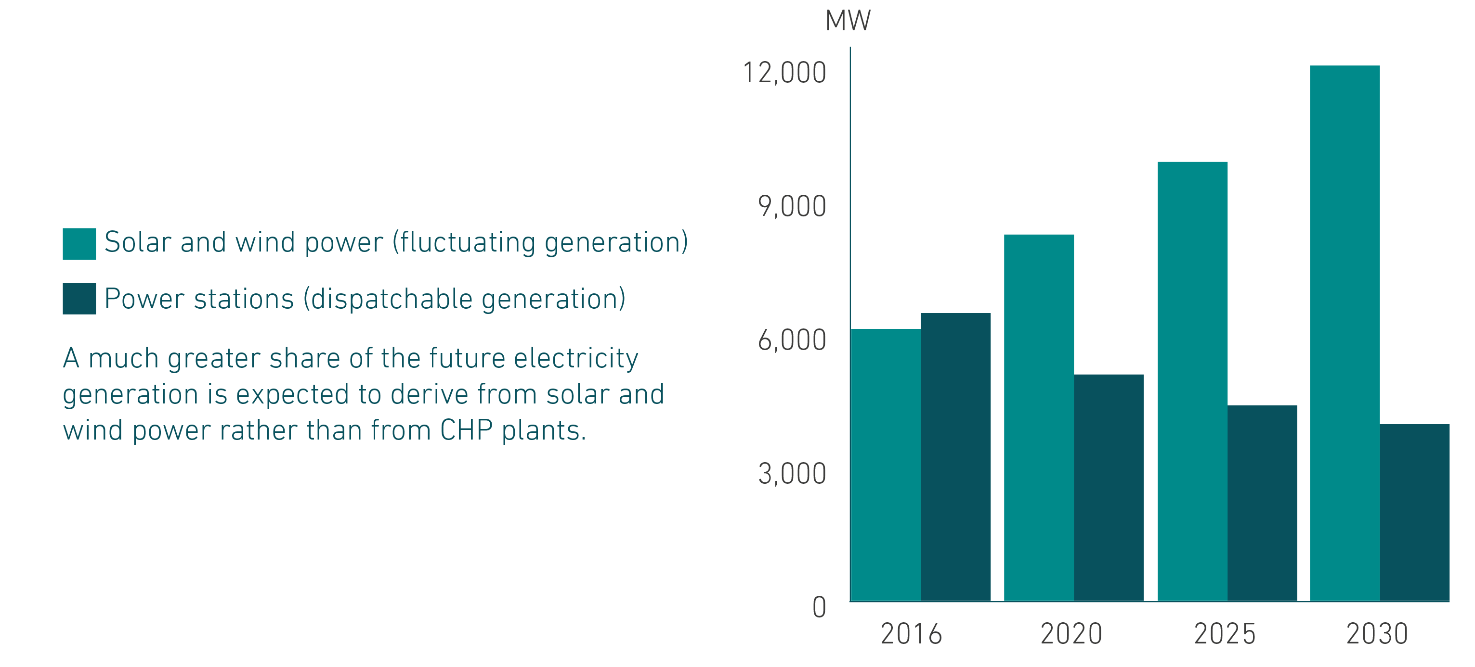
Future electricity generation capacity

Slide 8
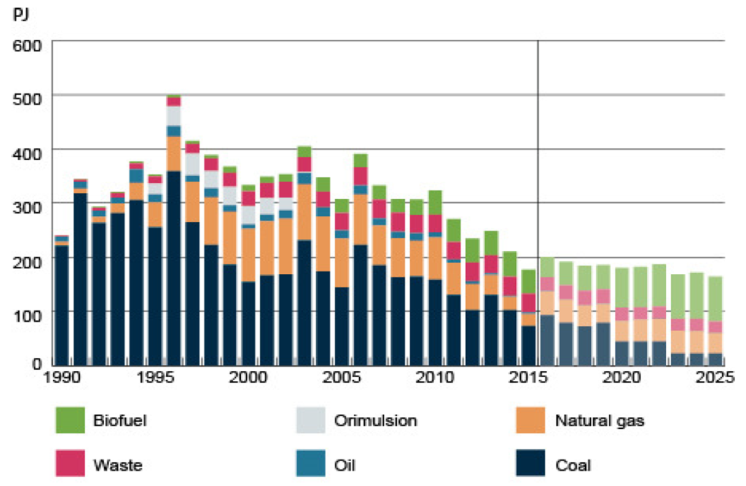
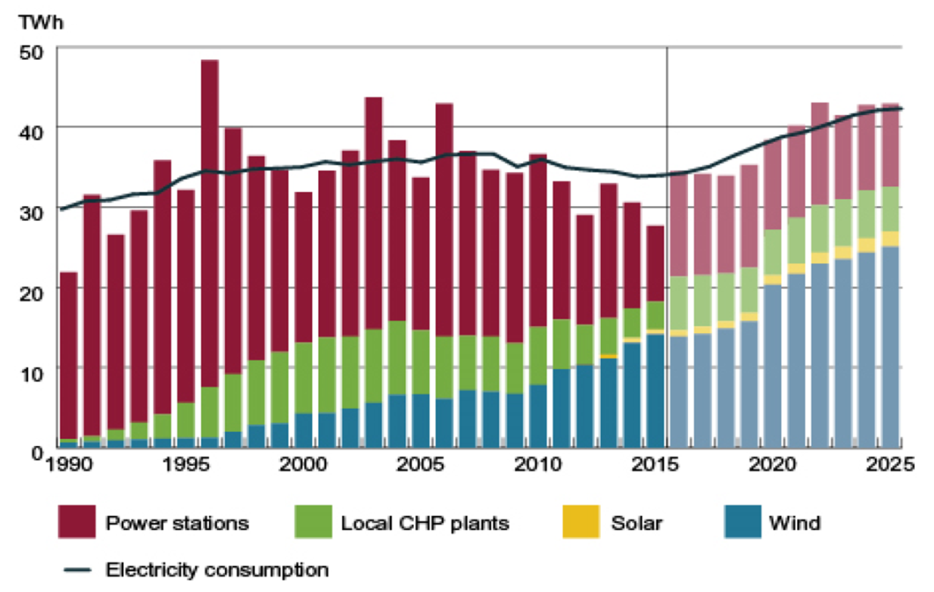
Development in Fuel consumption, demand and generation
Fuel for electricity generation
Demand and generation
Fossil fuel: -70%
Wind power/Demand = 42%

Slide 9
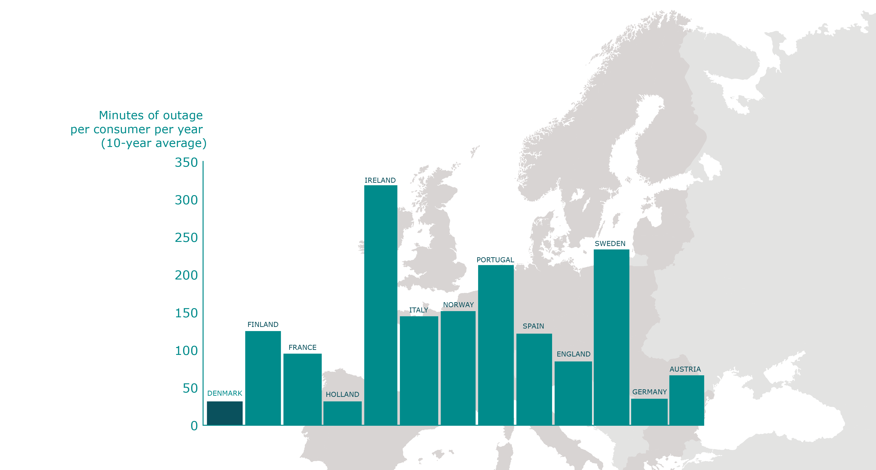
Outage minutes in Europe

Slide 10
Toolbox for efficient large scale RES integration
Strong transmission grids and interconnectors
International electricity markets
Flexible generation system
Specialized forecasting and operational planning tools

Slide 11
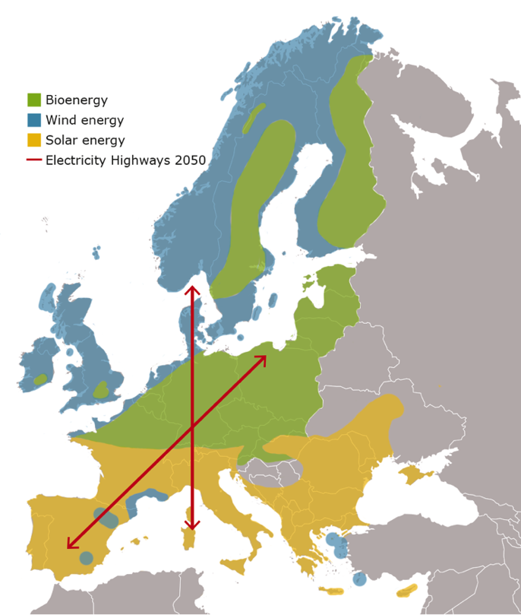
Transmission grids
New RES
Variable RES drives grid investments
Strong grids enable
    Optimal utilization of generation capacity
      merit order dispatch
    Balancing in larger diversified areas
    Sharing of reserves
    A positive business case for grid investments
Notes:
Ikke forbrug som driver

Slide 12
Market Coupling in Europe
– status and next steps
Nordic Region
Price coupling since 1999
(Eastern Denmark 2000)
Belgium, France, Netherlands (TLC)
Price coupling since 2006
Nordic region-Germany (operated by EMCC)
Volume coupling since November 2009
Central West Europe (CWE)
Price coupling since November 2010
CWE-Nordic region
(+ Estonia)
Flow calculated by EMCC
Prices calculated by PXs
Interim solution NWE: Interim Tight Volume Coupling (ITVC) since November 2010
Nordic region– SwePol/
Nordic region-Lithuania/
Nordic region-Latvia
Price coupling since
Dec. 2010 / June 2012/ June 2013
North West Europe (NWE) - One price calculation for entire area
Price coupling since
February 2014 = target model
NWE+SWE = MRC (multi regional coupling)
One price calculation
Price coupling since
May 2014
MRC + Italian borders
Price coupling since February 2015
4MMC – not yet coupled
to MRC
Price coupling since November 2014
Next Steps: Market Coupling of Intra day and Balancing Markets
Notes:
A target model is crucial
A stepwise approach is ok – as long as a targetmodel is in place
The Market Coupling in Europe has happened stepwise with regions being coupled one by one.

Slide 13
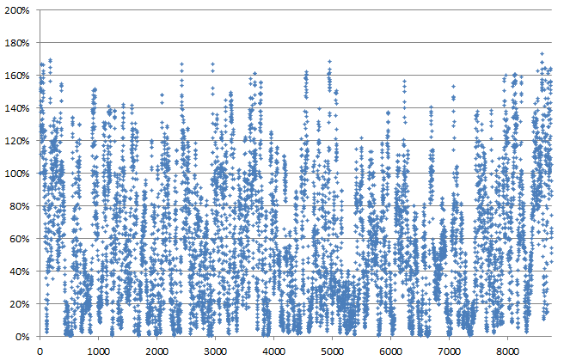
The Role of Interconnection
In 2015, the ENTSO-E electricity demand was 3278 TWh of which 468 TWh was traded across borders.
Interconnection allows for market integration; for the cheapest resources to cover as much demand as possible, which in turn reduces cost for all.
It also facilitates renewable energy integration, sharing of reserves and helps ensuring security of supply.
Percentage of Demand in Denmark West covered by wind power
Must be exported
or curtailed
Can cover internal
consumption
Hour number in 2015

Slide 14
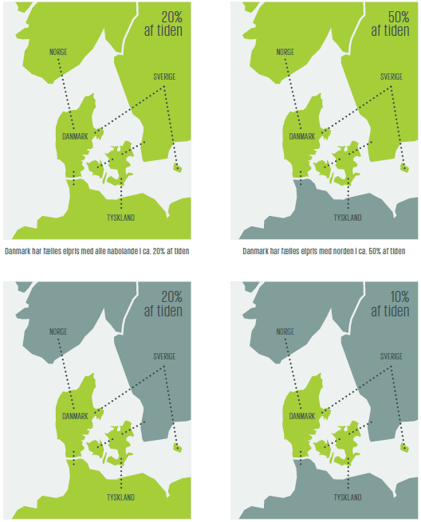

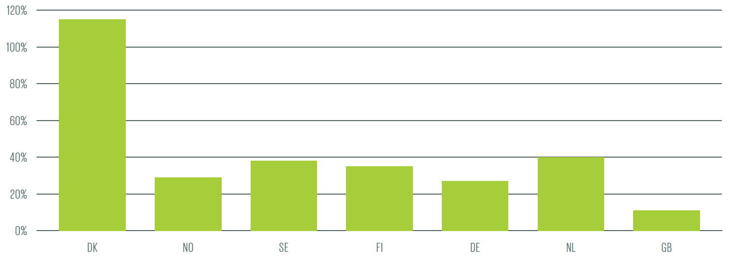

Interconnection and price formation in Denmark
20% of the time
50% of the time
Denmark has a very high degree of interconnection.
This leads to Denmark often sharing a price level with a neighbouring area, and only for about 10% of the time will Denmark have a unique price.
Interconnector Capacity in percentage of peak load
20% of the time
10% of the time

Slide 15
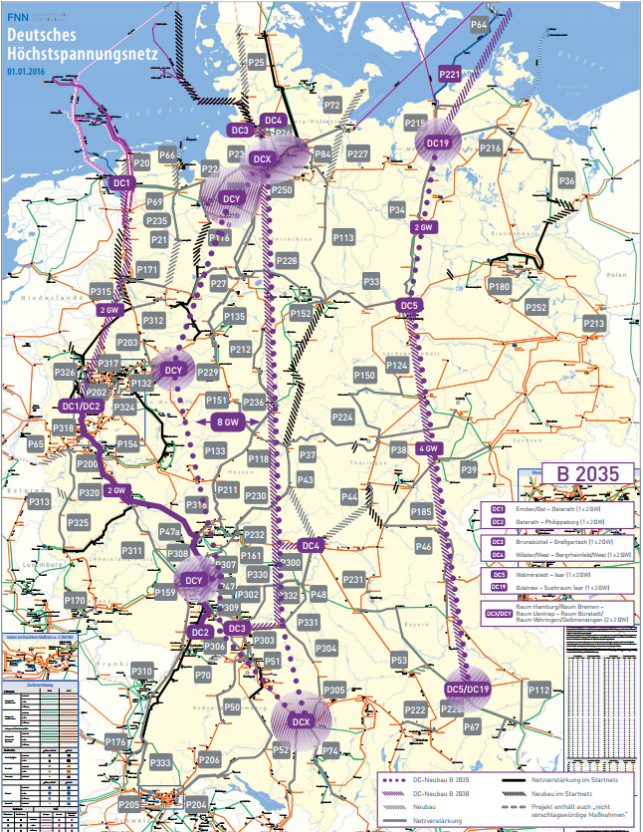
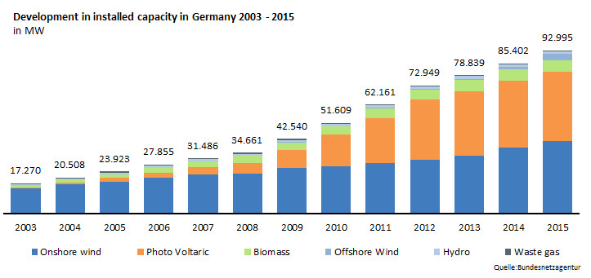
The Challenge
Will the grid develop fast enough?
Grid development is always running the risk of ”Too little too late”

Slide 16
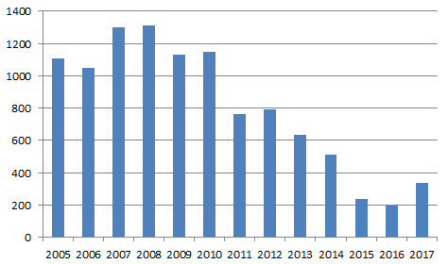
The consequences of “too little too late”
Green transition must be accompanied by the necessary grid development
Bidding zones should reflect the physics – otherwise internal bottlenecks and loop flows will “pollute” prices and flows
  Internal bottlenecks moved to the border!
Average DK1 → DE capacity [MW]
Year

Slide 17
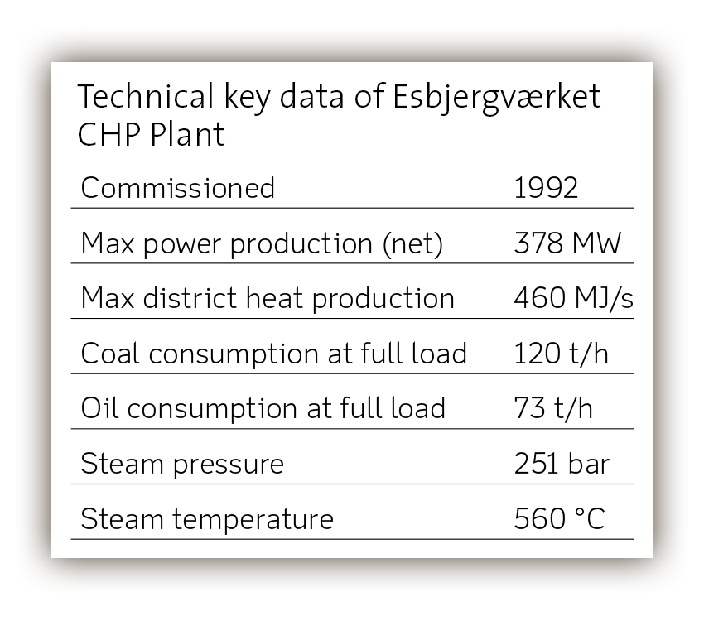
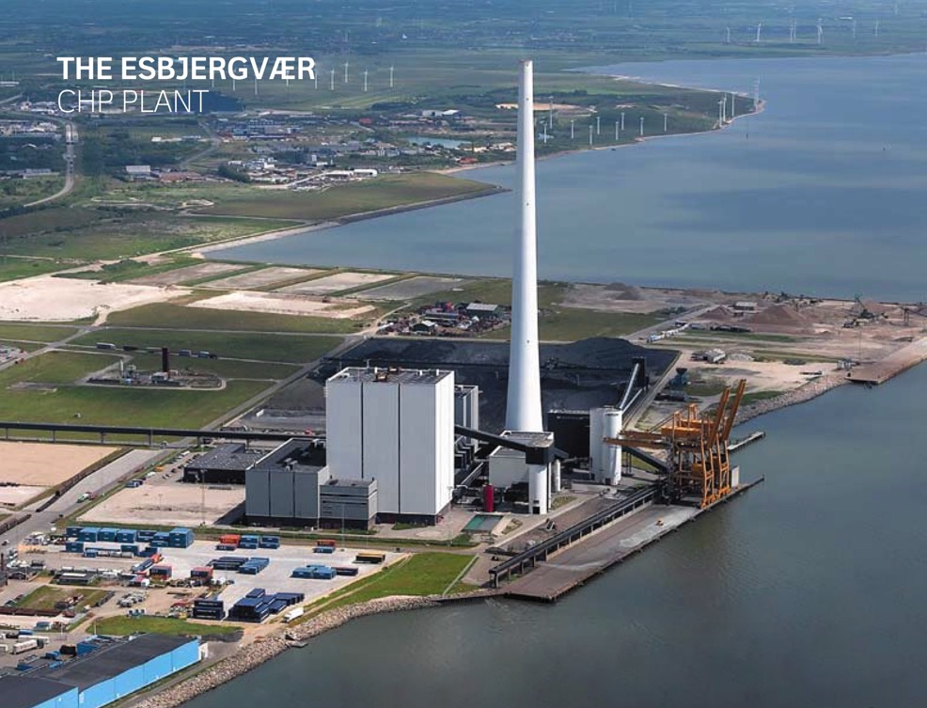
High flexibility of power Plants
Operational range:
10–100%
Regulating rate:
3-4% per minute
Heat accumulators and electric boilers
Source: Dong Energy

Slide 18
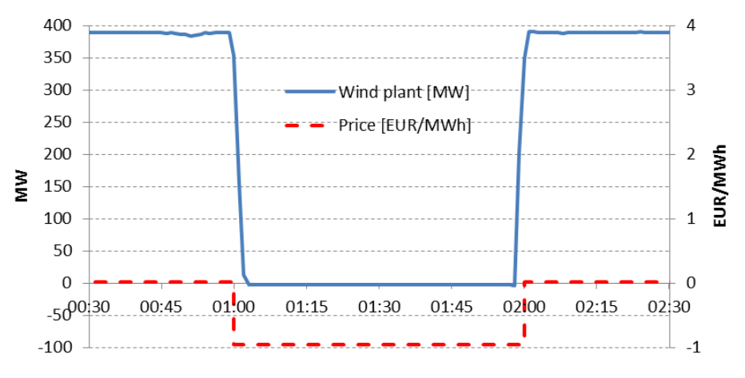
Offshore wind farm shutdown during negative prices

Slide 19
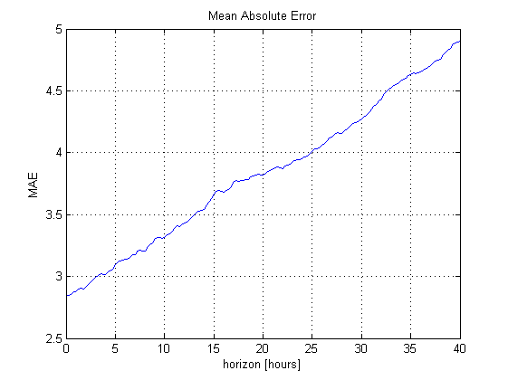
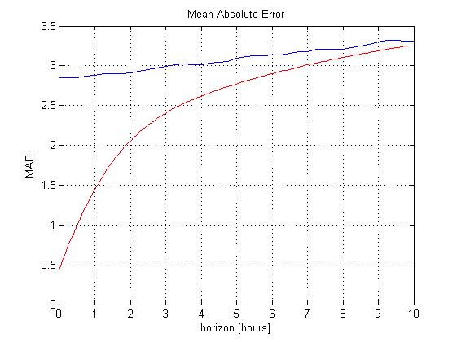
Wind Power Forecasting
+ on-line measurements !

Slide 20
Toolbox for efficient large scale RES integration
Strong transmission grids and interconnectors
International electricity markets
Flexible generation system
Specialized forecasting and operational planning tools

Slide 21
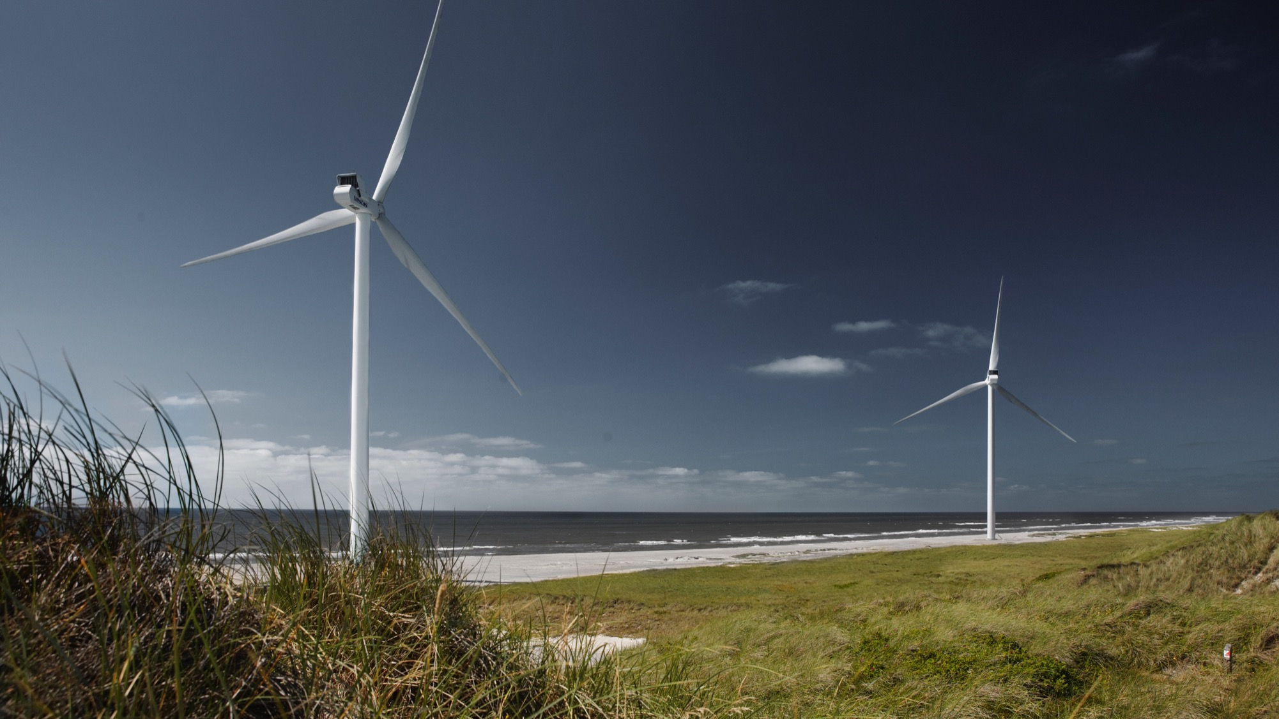
THANK YOU FOR THE ATTENTION
WWW.ENERGINET.DK
Notes:
We contribute to the Danish political target that by 2050 all our energy consumption must be covered with renewable energy sources.
[The speaker may choose to add own examples under the key message, for example:
In 2016, wind power covered 38% of the Danish electricity consumption.
We get power from Horns Rev 3, which is one of the world's largest offshore wind farms. We install an offshore transformer platform and
connect it to the onshore electricity grid via a submarine cable. 400 MW Horns Rev 3 can generate power to 400,000 households.
- We work with Europe to develop tomorrow's green gas. Energinet has taken the initiative to work with five European transmission companies to ensure 100% CO₂-neutral gas supply by 2050.
- Energinet provides a system for the management of certificates of origin within the electricity and gas area, allowing consumers to trace the origins of the electricity and gas they buy from renewable energy sources.]

